Slide 1
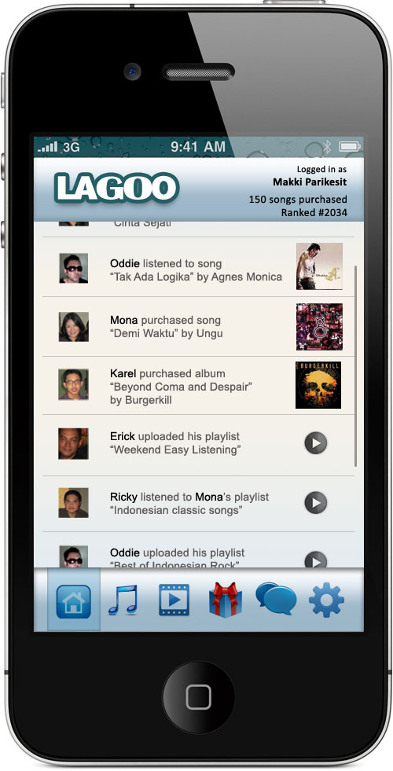
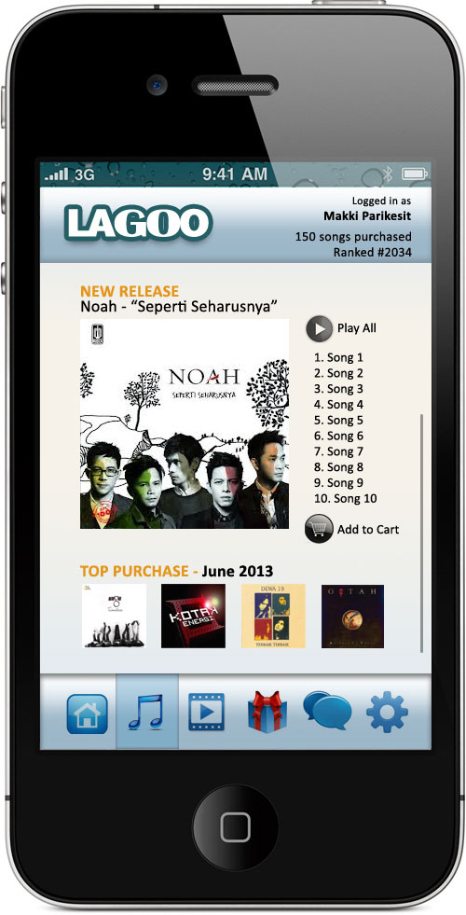
Lagoo
Indonesian Premiere Online Digital Music & Video Store

Slide 2
What Is Lagoo?
At its core, it is an online digital music and video store that serves downloadable Indonesian music and video content
It helps Indonesian musicians, records labels, video makers, production houses, and TV stations to sell digital version of their products easily
Available on desktop, web, and mobile platforms (with focus on mobile platforms)
Provides simple payment methods via top-up card, ATM transfer, etc. as well as via affiliation with 3rd party payment gateway company such as Doku.

Slide 3
How’s it different from iTunes?
It is specifically targeted for the Indonesian market
Beside its desktop and web version, Lagoo is available for all mobile platforms: iOS, Android, Blackberry, and Windows 8 Mobile
Easier and more varied payment method, no credit cards required
Easier submission process
Better profit sharing scheme than iTunes
Digital content owner is free to set their own price per content, with the minimum price of Rp. 500 for song and Rp. 10.000 for video
It has social networking element which will greatly improve Lagoo’s marketability. Lagoo combines the popular features of iTunes, Last.fm, and social media channels not unlike Path or Instagram.

Slide 4
How do I sell?
Digital content’s copyright/publishing rights owner sign up (create account) to Lagoo’s website
Must provide proof of identity as well as proof of copyright/publishing right ownership
Convert their content into the acceptable formats described in Lagoo’s guidelines
Upload the digital content and set their selling price
Content will be checked by Lagoo’s team and if all is well then content will be published on Lagoo’s platform

Slide 5
How do I buy?
User signs up on Lagoo’s website, create their profile, and after an e-mail confirmation process has been done, they will instantly be able to login on the desktop, web, or mobile platform
To login, user will input their user ID, which is a string of unique numbers generated when they signed up, and their password
New user will immediately get Rp. 5000 credits which they can freely spend on music or video purchase
Once logged in they can immediately start browsing and buy
User can top up their online credits via ATM transfer, top up cards at participating outlets, credits gifted by other users, mobile/internet banking, credit cards, etc.

Slide 6
Lagoo Mobile App
Lagoo Mobile Application will be downlable on:
Google Play (Android Market)
Blackberry’s AppWorld
Windows Phone Apps Store
Apple App Store (iOS)
Lagoo Mobile Application will be free to download
All platforms will serve identical experiences

Slide 7
What can you do on Lagoo Mobile App?
Browse and purchase songs (or full albums) and videos as digital download
Store it on your mobile device
You may transfer your purchased content to unlimited number of devices you own
Create and share your playlist
Like or Comment on other people activities on Lagoo Mobile
Listen to streaming song samples/excerpts
Send gift to other user in the form of store credits or songs
Create groups of friends who share similar taste in music / movie

Slide 8

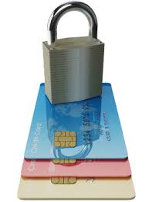
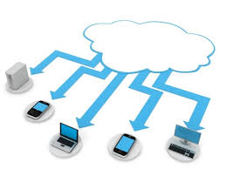
Lagoo Network
Lagoo’s Content Server
Payment Gateway
Internet
Web
Mobile
Phone
Laptop
Tablet
Desktop

Slide 9
Monetizing
Sales of digital song, album, and movie
Online advertising banner
Sponsorship
Tied-ins with sales of merchandises

